Slide 1
Cloud Native Software Development
Notes:
Introduction to the Cloud

Slide 2
Overview
The enemy of scalability: state
The Twelve Factor App
Monitoring and metrics collection
Microservices
Service meshes, Frameworks, and Tools

Slide 3
The Enemy of Scaling: State
Source: Unsplash/Michael under Unsplash License

Slide 4
Stateless applications
Load Balancer
Autoscaling Group
Application Server
Application Server
Application Server
Database

Slide 5

Sessions
Application
Database
Login, user=root, password=asdf
Store session id=512345434, user=root
OK, session ID=512345434
Get secret, session ID= 512345434
Fetch session id=512345434
User=root
Here you go

Slide 6
The 12 Factor App
Source: Unsplash/Mitchel Lensink under Unsplash License

Slide 7

1. Codebase

Slide 8
2. Dependencies

Slide 9

3. Configuration
Application

Slide 10
4. Backing Services
Connection Config
Application Server
Database

Slide 11
5. Build Process
Code
Build
Release
Config

Slide 12
6. Stateless Processes
Load Balancer
Autoscaling Group
Application Server
Application Server
Application Server
Database

Slide 13
7. Network Configuration
HTTP
Other Components
Other Components
Application

Slide 14
8. Process Handling
Worker.5
Worker.4
Scale
Web.3
Worker.3
Web.2
Worker.2
Web.1
Worker.1
Process Types

Slide 15
9. Disposability
Processes should start and stop quickly.

Slide 16
10. Development/Production
Continuous, automatic rollout
Smaller changesets

Slide 17
11. Logs
Simple logging to the standard output.
Standardized format (e.g. JSON)

Slide 18
12. Tooling
Tools should be runnable from the program directory.

Slide 19
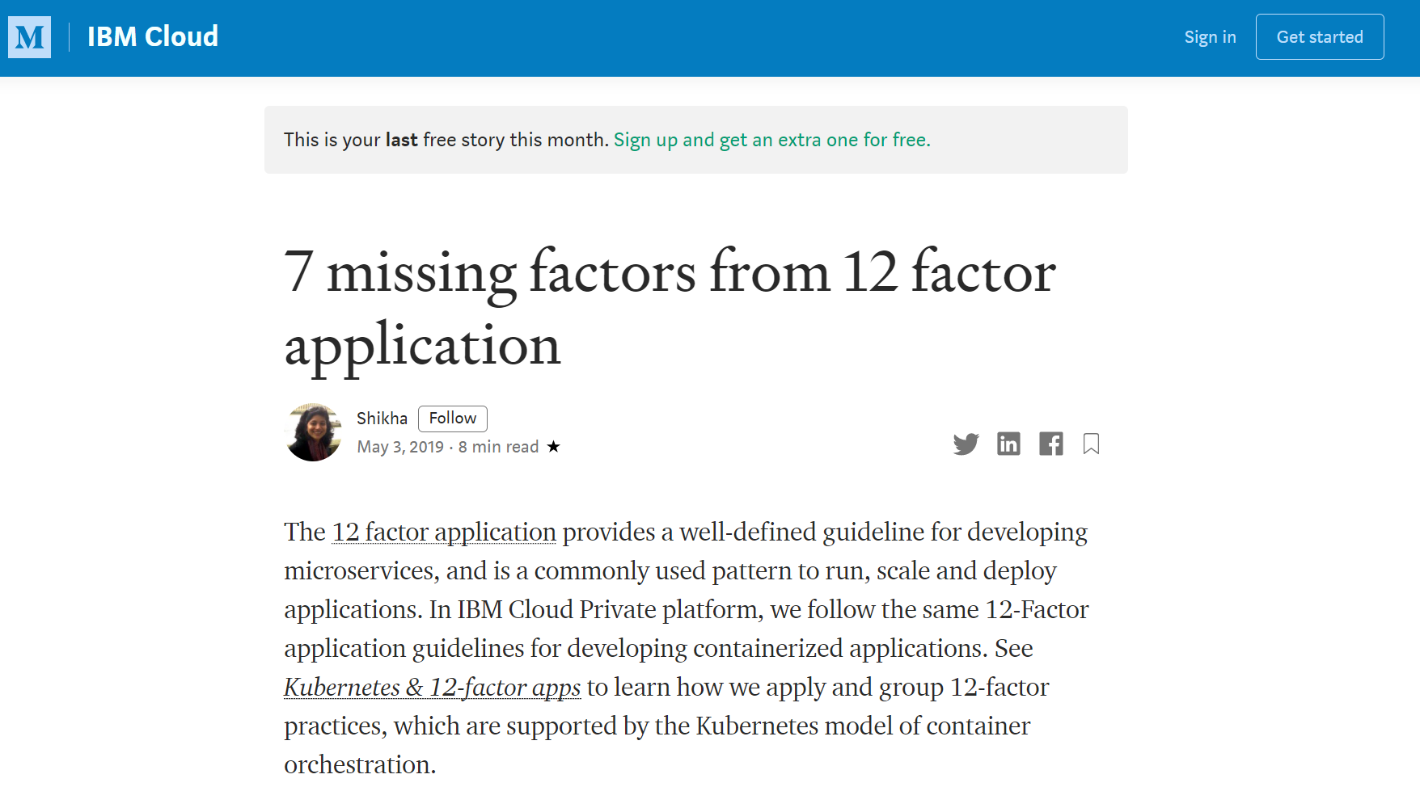
Additional Factors

Slide 20
Monitoring & Metrics
Source: Unsplash/Stellan Johansson under Unsplash License

Slide 21
Periodic Checks
Monitoring System
Application

Slide 22
Periodic Checks (Containers)
FROM ubuntu:20.04
RUN apt update &&
apt install –y nginx &&
rm /var/lib/apt/lists/*
CMD ["/usr/sbin/nginx","-g","daemon off;"]
HEALTHCHECK CMD curl --fail http://localhost || exit 1

Slide 23

Feature tests

Slide 24
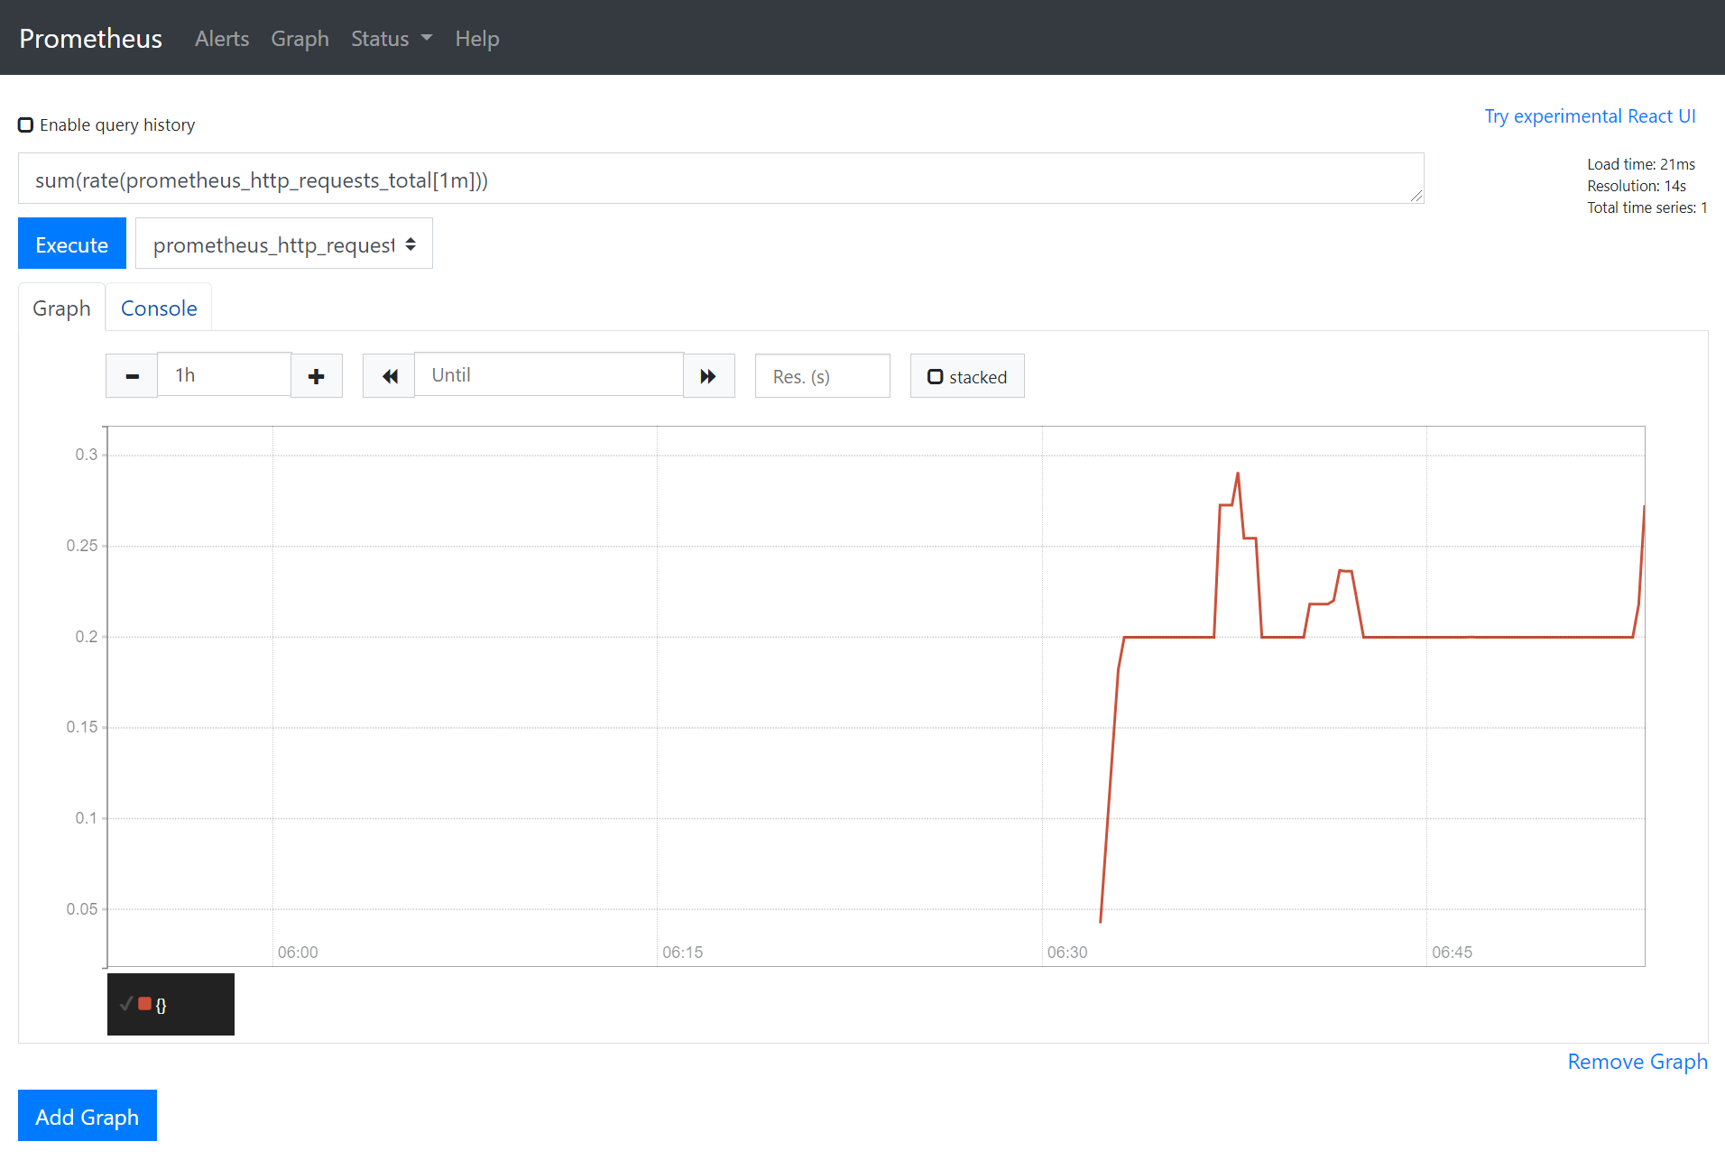
Metrics Collection

Slide 25
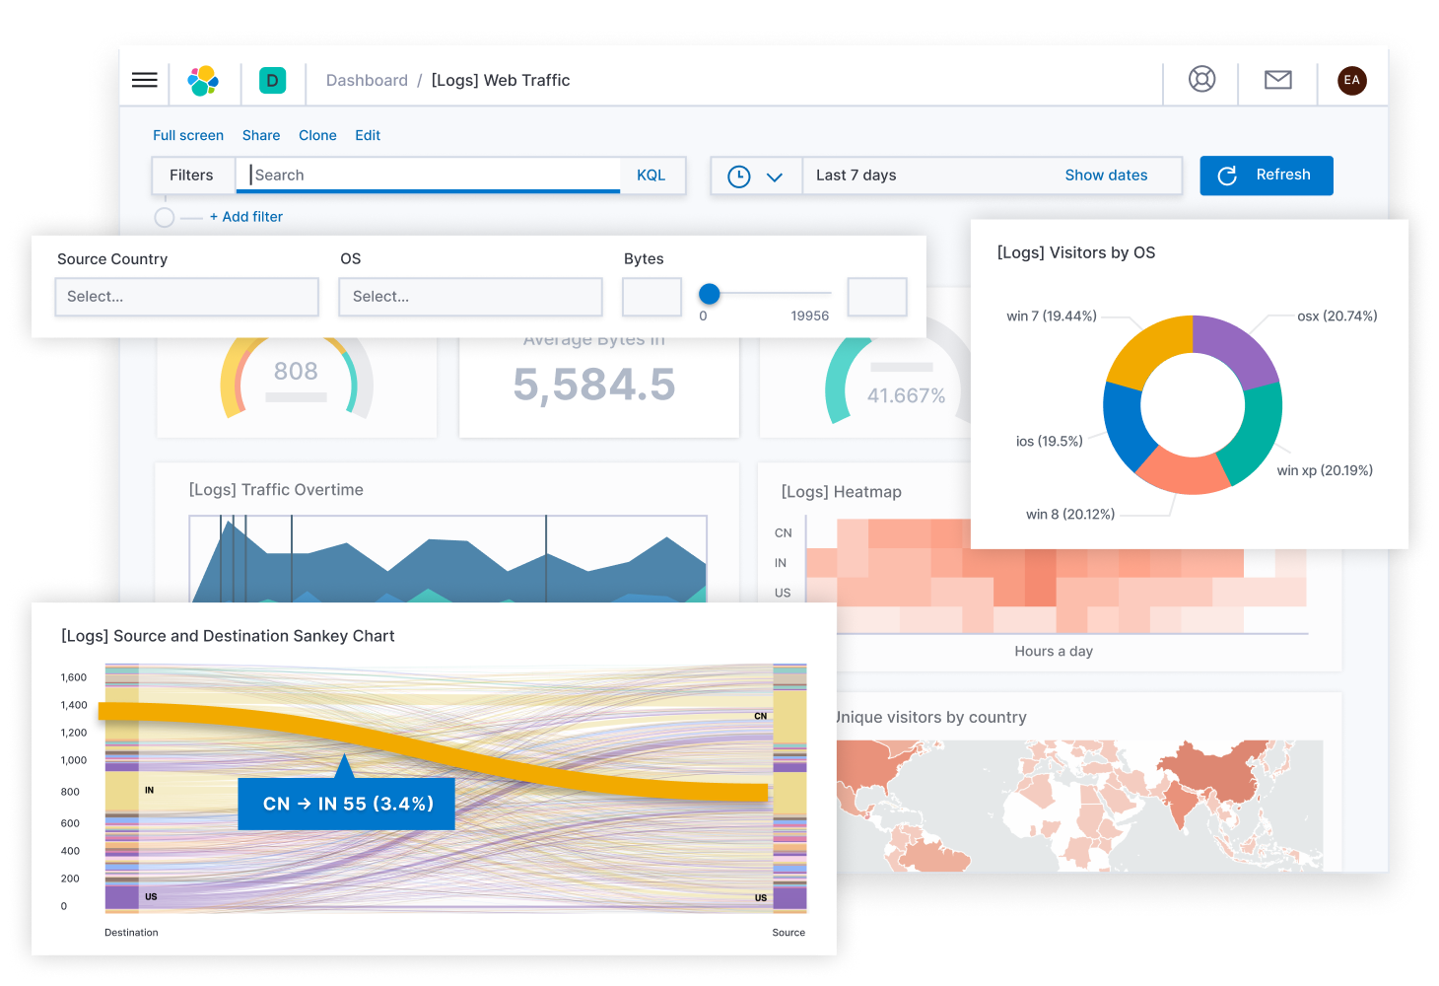
Log Collection
| Source: Elasticsearch B.V.

Slide 26
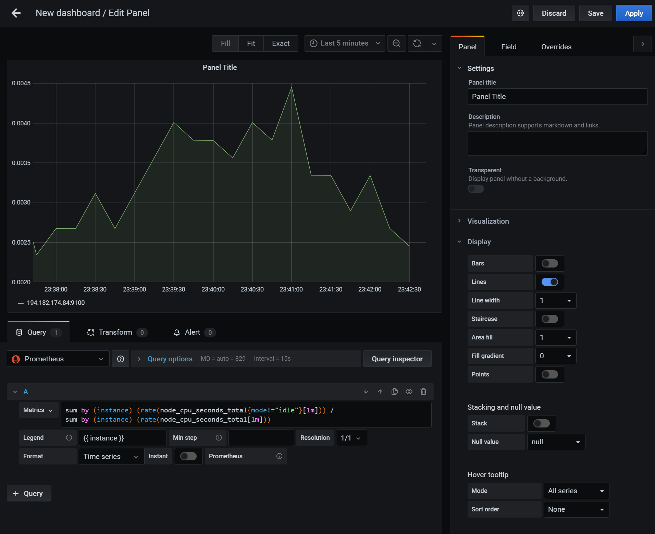
Dashboards

Slide 27
Microservices
Source: Unsplash/Trần Toàn under Unsplash License

Slide 28
Basics
Frontend
Ordering
Billing

Slide 29
Clean API Boundaries
Frontend
Ordering
Billing

Slide 30
Network
Frontend
Ordering
Billing

Slide 31
Response time
Frontend
200ms
Ordering
200ms
Billing
200ms

Slide 32
Conway’s Law
Frontend Team
Backend Team
Billing Team

Slide 33
Technology
JavaScript
Java
Python

Slide 34

Service Meshes, Frameworks
Source: Unsplash/Xiong Yan under Unsplash License

Slide 35
Service Meshes
Help with API versioning.
Implement a circuit breaker.
Can span multiple Kubernetes clusters.

Slide 36
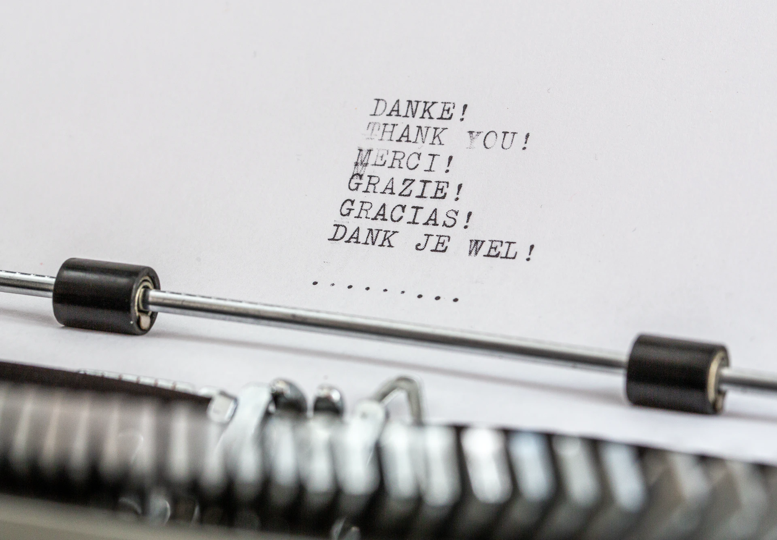
Thank you!
Source: Unsplash/Wilhelm Gunkel under Unsplash License

